Slide 1

Deep Reinforcement Learning and Cybersecurity for Self Driving Cars
Mohamed Korium, Mohamed Saber, Eslam Abd elwahed, Arun Narayanan
With Assoc Prof. Pedro Juliano Nardelli

Slide 2
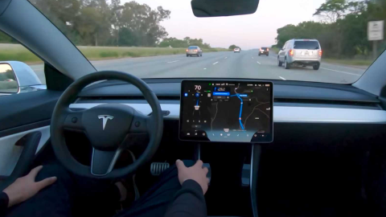
Outline
Introduction
Deep Reinforcement learning for self driving cars
Motivation behind using Deep Reinforcement learning
Methodology
Results
Cybersecurity Models for detecting Internet of Vehicles Cyberattacks
Motivation behind Cybersecurity
Methodology
Results

Slide 3
Problem Statements
Train vehicle using Deep RL algorithms in CARLA Simulator.
Is to find the most suitable Deep RL algorithm that can be used to train on days of driving.
Scene understanding (awareness) of the surrounding environment to take a successful action in winter conditions.
Tradeoff between exploration (keep taking random actions to gain more knowledge) and exploitation (use the gained knowledge to take actions based on your collected experience).

Slide 4
Methodology
Decision-making system of autonomous driving
Imitation learning (Supervised Learning) involves a supervisor that provides data to the learner.
Reinforcement learning means the agent has to explore in the environment to get feedback signals.
On the one hand, realizing such a scheme is quite complicated, since it needs to handle all layers of the driving task, on the other hand, even with the full knowledge of the current state of the traffic, the future behavior or intentions of the surrounding drivers are unknown, making the problem partially observable.

Slide 5
Methodology
Deep Reinforcement Learning is a generally figuring out predictive perception through trial and error, therefore it is a promising solution, especially in the domains of driving policy, path and motion planning, etc...
Deep RL has been successful used in complicated tasks with lower prior knowledge.
Can successfully learn from visual perceptual inputs made up of thousands of pixels.
Able to solve a wide range of complex decision-making tasks that were previously out of reach for a machine.
Deep Reinforcement learning gains from feedback and usually linked with environment interaction with optimal control.
Deep Reinforcement learning trades off between exploration and exploitation.
From EECS6892 reinforcement learning by Zijun Wei

Slide 6

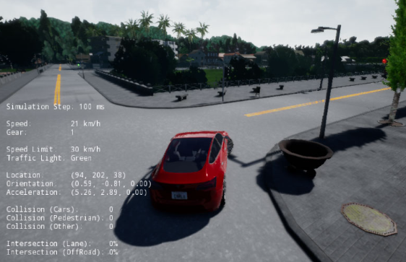
Markov Decision Process
Markov Decision Process (MDP):
Is a mathematical framework to describe an environment in reinforcement learning.
We normally use MDP to formalize the sequential decision-making problems.
The goal of the MDP is to find optimal policy.
What is the best action that AVs can do, to move from this state to another state.
Current State
Reward
Agent
Environment
Action
Episode

Slide 7
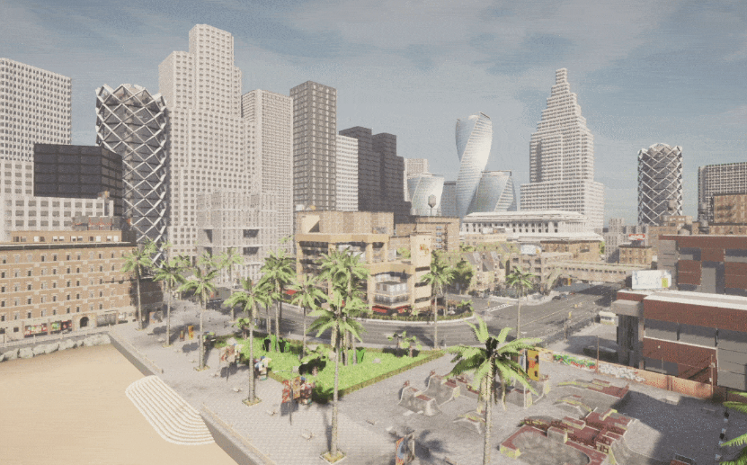
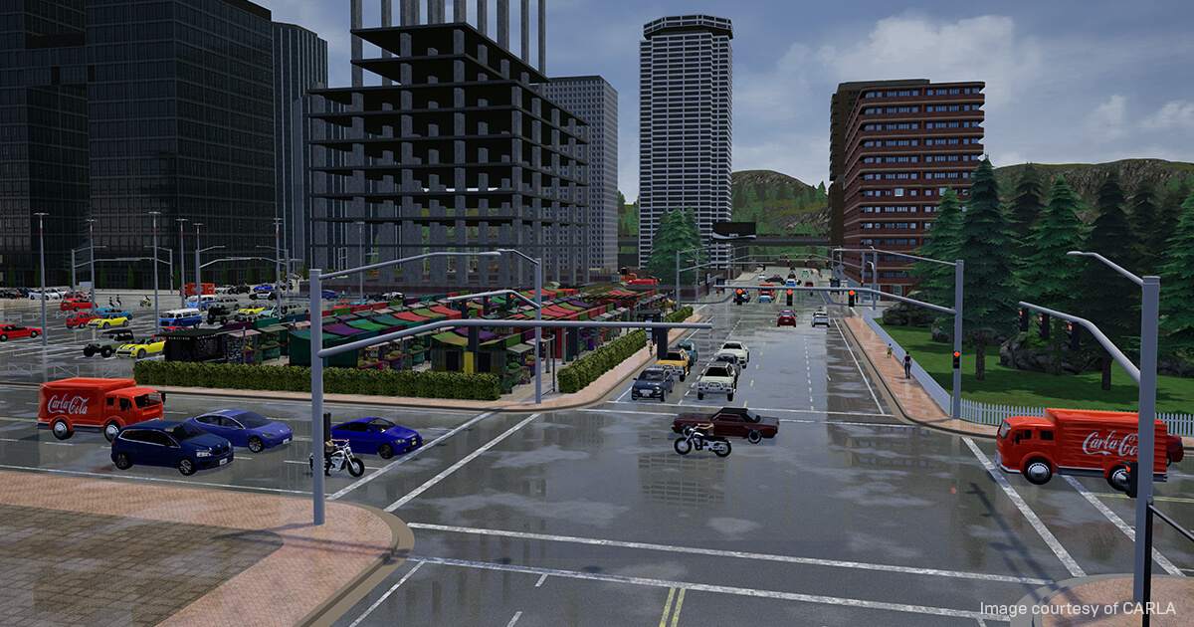
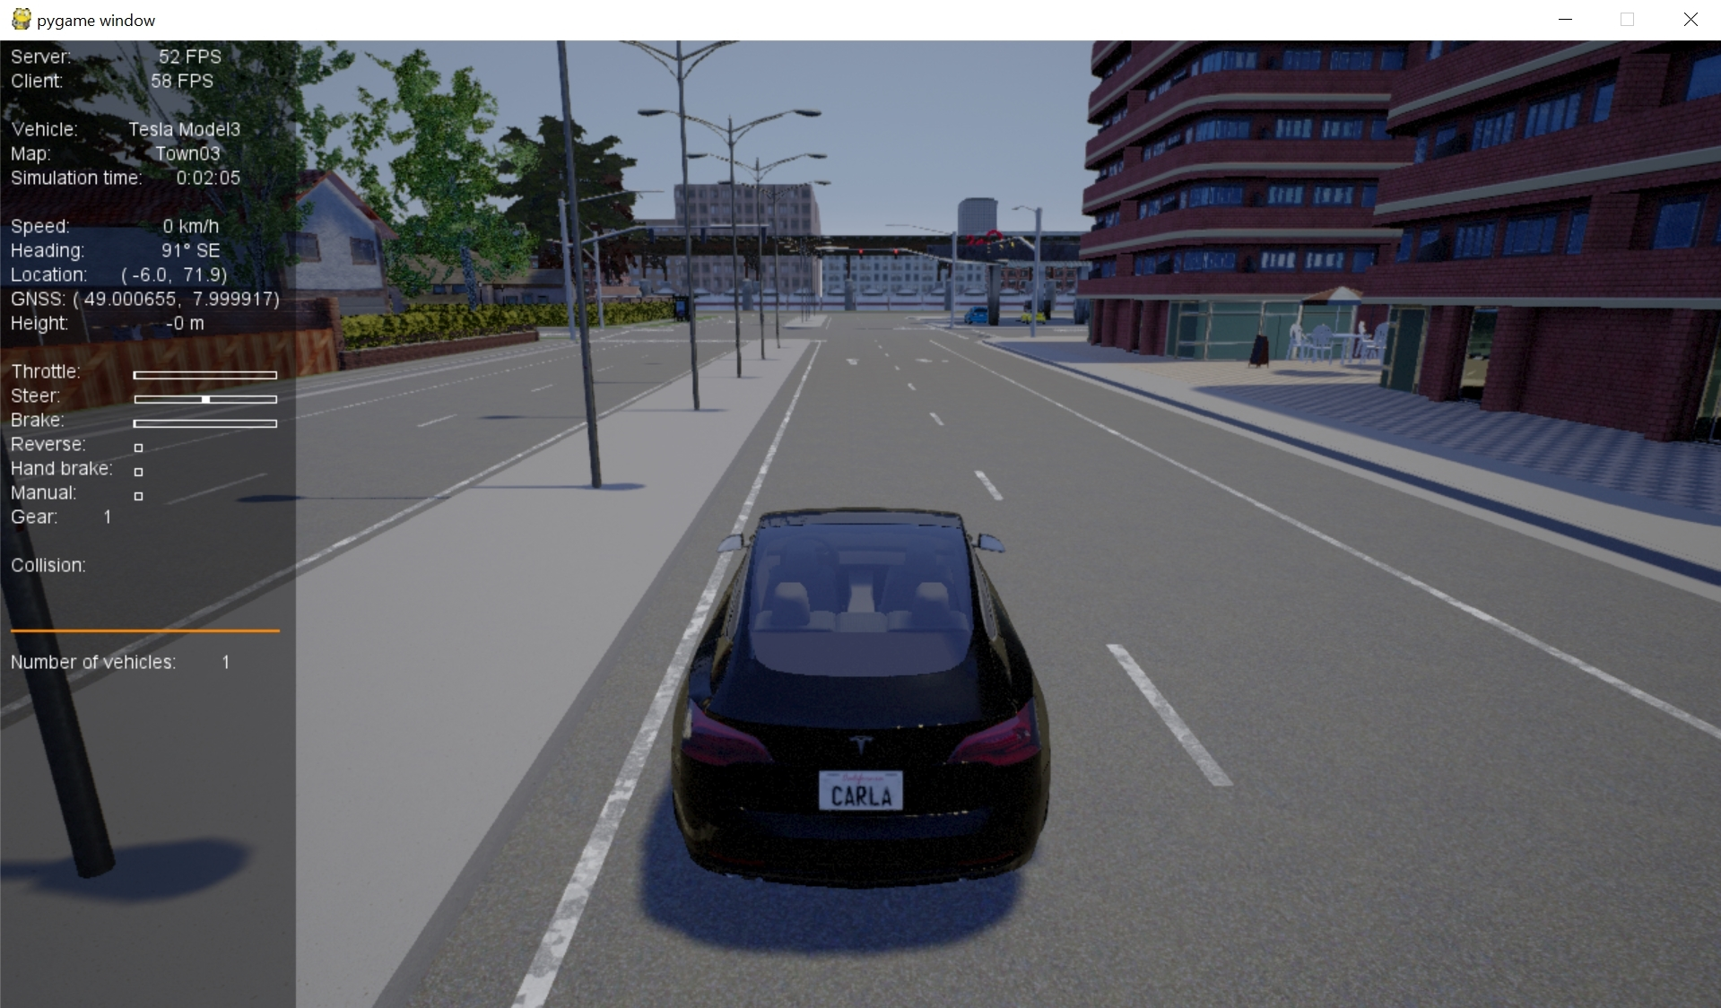
Environment Preparation
We need to connect the Python client to the server through any open port. (Port can be chosen as any available port and is set to 2000 by default).
The “world” object provides access to all elements of the simulation, including the map, objects within the map, such as buildings, traffic lights, vehicles and pedestrians.
Populate our simulation with some vehicles to simulate a real environment with traffic and other road users or non-player characters (NPCs).
Spawn our own car “Model 3”
Spawn 3 sensors (RGB, Depth, and collision sensors)
Attach the sensors to the Model 3

Slide 8
Parameters
Goal is to train our “Tesla model3” in CARLA:
The speed of the car must be 50 km\h, not less.
Timestep: 50,000*30 = 1,500,000
Learning hours was from 15-18 hours
Episode ends after 1 minute or if collision sensor has detected a any collision to any buildings, traffic lights, vehicles, or pedestrians
Discrete Actions: Four actions (throttle, brake, left, right).
States: Is the data collected from the sensors (RGB, Depth, and collision sensors).
Rewards:
Crashing pedestrians : [-200]
Speed less than 50 km\h: [-1]
Speed more than 50 km\h: [+1]

Slide 9
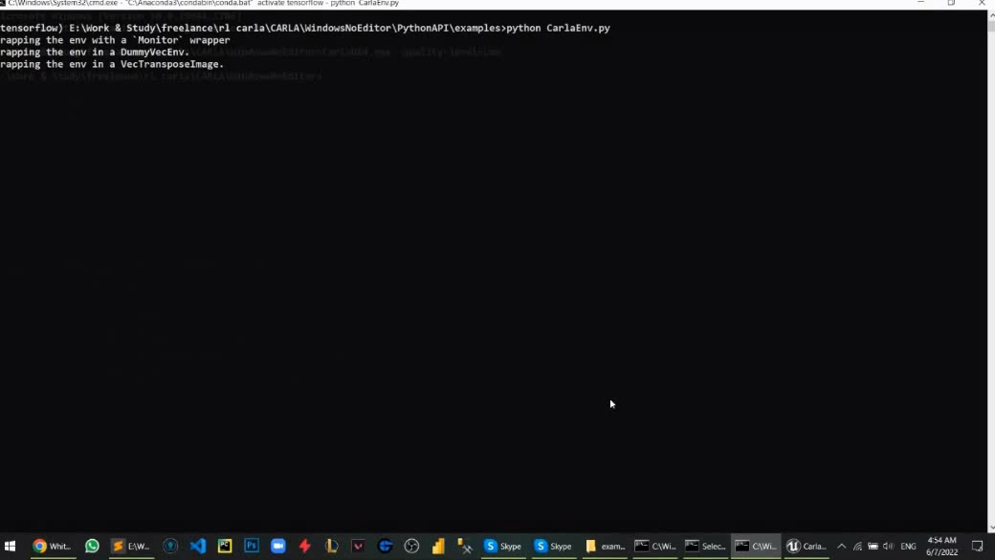
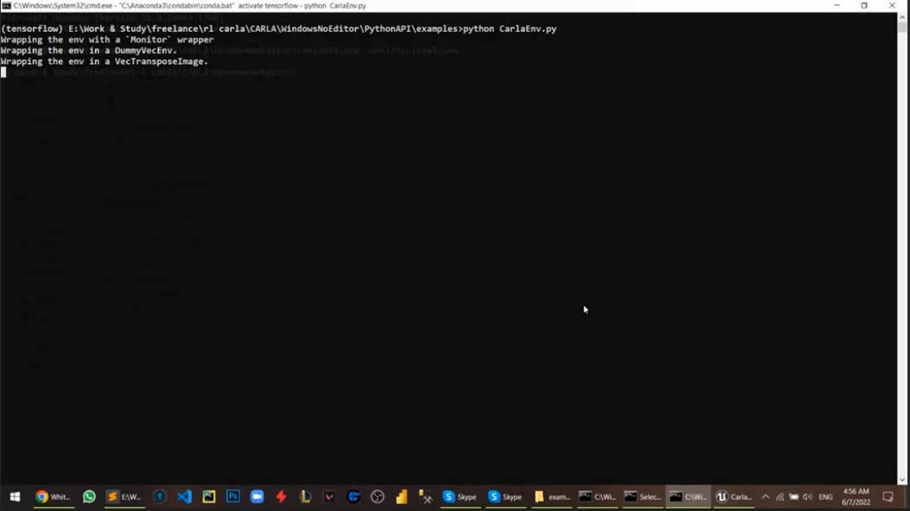
Tests
Day 1:
No results
DQN algorithm takes a lot of storage, memory, and a lot of time for calculating the Q-learning values.
After 7-hours learning
Speed about 50 km\h (+1)
Collision (-200)
Day 2:
PPO algorithms : it achieves the maximum reward in less steps and with very less variance. It even takes less time to train.
The vehicle learned that collisions means -200 from the environment. Therefore, it started to move in circles to avoid crashing, although it takes ( -1) for each step because speed is less than 50 km\h

Slide 10
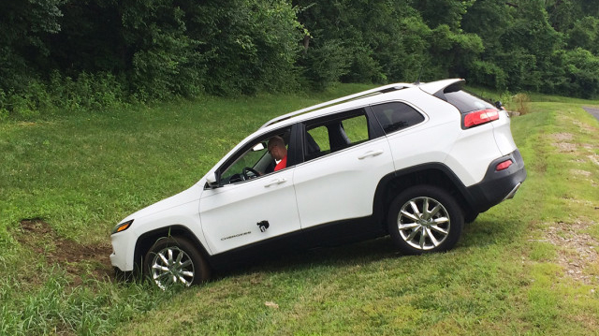
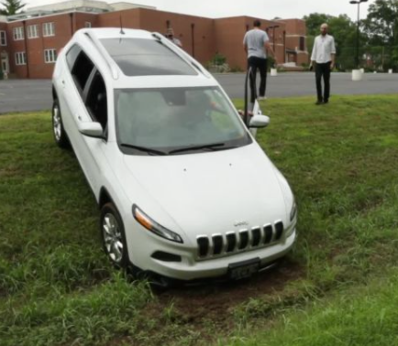
Cybersecurity
In 2015, two automotive cybersecurity researchers (Charlie Miller and Chris Valasek) represented a new arsenal of attacks against the Jeep Cherokee, where they remotely hacked into the car and paralyzed it on highway I-64 in U.S, they were able to:
They were able to disable the car's transmission and brakes at any speeds by sending carefully crafted messages on the vehicle's internal network known as a CAN bus.
They were able to take over the steering wheel.
They were able to track the car with its GPS navigational system and change its destination.
Completely control the music player and AC .
This has led to Fiat Chrysler recall of 1.4 million Cars after Jeep vulnerability exposed.

Slide 11
Problem Statements
Building a cybersecurity model with a high detection rate to effectively identify Internet of vehicles attacks at low time complexity and with high efficiency that can protect the communications systems from numerous typical threats.
To ensure that our AV’s trained vehicle in CARLA simulator:
Always behaves correctly when faced with unexpected situations or malicious attacks.
It could take secured sequences of actions that is always behaves correctly when faced with unexpected situations or malicious attacks.

Slide 12
Methodology
To achieve this, we made four steps of the machine-learning process, i.e.,
Data preprocessing that makes the dataset suitable for the proposed method.
Feature selection using a regression model that simplifies the model complexity and reduces computational time.
Running machine learning algorithms with hyper-parameters to control the behavior in the training phase.
Machine learning algorithms such as:
Random Forest ({RF}).
Extreme Gradient Boosting ({XGBoost}).
Category Boosting ({CatBoost}).
Light Gradient Boosting Machine ({lightGBM}).
Performing ensemble learning to reduce the dispersion of the predictions and to prevent over-fitting.

Slide 13
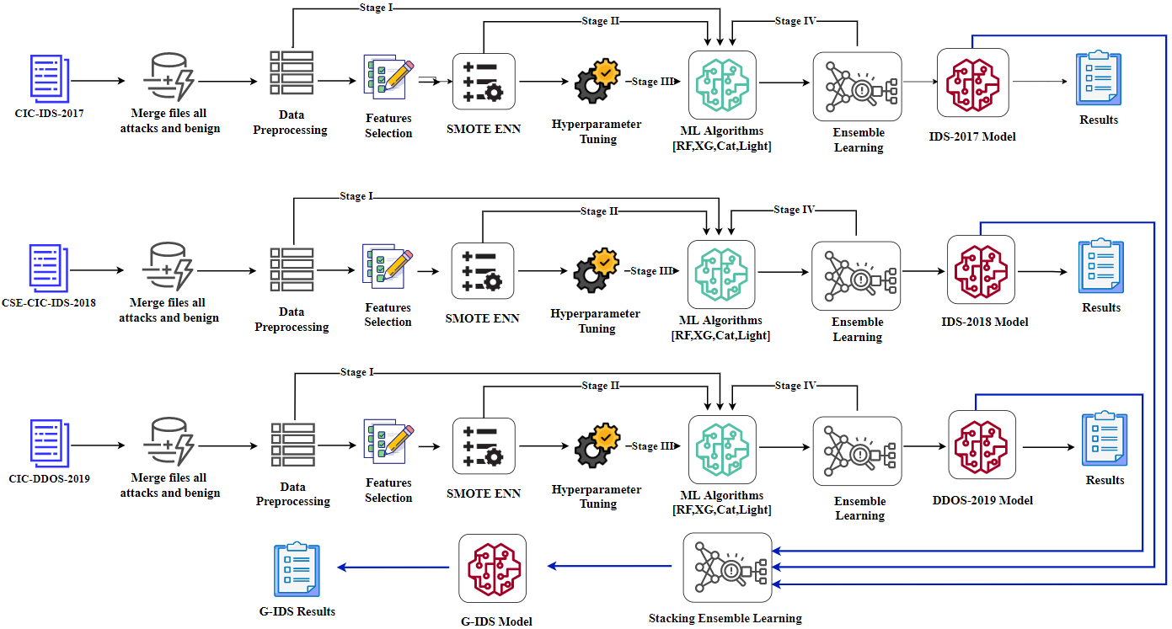
Proposed G-IDS Framework
G-IDS is designed to identify both known and new cyberattacks on vehicle networks considering three different datasets at the same time:
CIC-IDS-2017
CSE-CIC-IDS-2018
CIC-DDOS-2019
The main attacks are:
Denial-of-Service (DoS)
Distributed Denial-of-Service (DDoS) Attack
Port-Scan
Brute-Force
Infiltration

Slide 14
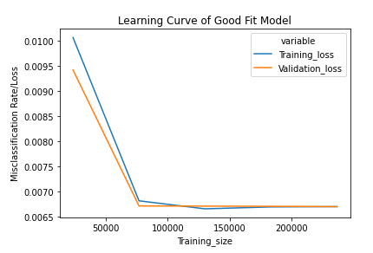
Results
Experimental results illustrate that our proposed IDS detection models can detect internet of vehicles attacks with:
100% accuracy on CIC-IDS-2017.
99.91% accuracy on CSE-CIC-IDS-2018.
99.81% accuracy on CIC-DDOS-2019.
99.21 % accuracy on all merged datasets.
The average processing time of each data packet on a vehicle-level machine is about 31.2 seconds.

Slide 15
Future Work
Different deep RL algorithms to compare the performance using smaller batch size to make the training faster.
The DQN algorithm is unstable, due to the increased variance in Q value learning.
Define waypoints (Global position estimation and local position tracking).
Customize the collision sensor rewards (according to categories)
We will perform internet of vehicle cyberattacks by our own on CARLA simulator, so we could test our G-IDS model for detecting and preventing on our model 3 vehicle.

Slide 16
Thank you for Listening ☺ Any questions ?

